Slide 1
MARKETING ANALYTICS I
SESSION 11:
SCORING MODELS FOR
CUSTOMER ACQUISITION
Professor Sonnier
Texas MSBA Program
Fall 2022

Slide 2
THE ESSENCE OF MARKETING
Customer Acquisition and Retention
Customer
Acquisition
Customer
Retention
“The purpose of a business is to create and keep a customer. To do that you have to produce and deliver goods and services that people want and value at prices and under conditions that are reasonably attractive relative to those offered by others to a proportion of customers large enough to make those prices and conditions possible.”
-- Theodore Levitt, “Marketing and the Corporate Purpose” in The Marketing Imagination (New York: Free Press), 1986.

Slide 3
CUSTOMER ACQUISITION
How Do Firms Acquire Customers?
Inbound Marketing
Search engine optimization
Blogs
Social media
“Viral” marketing
Content Creation and Distribution

Slide 4
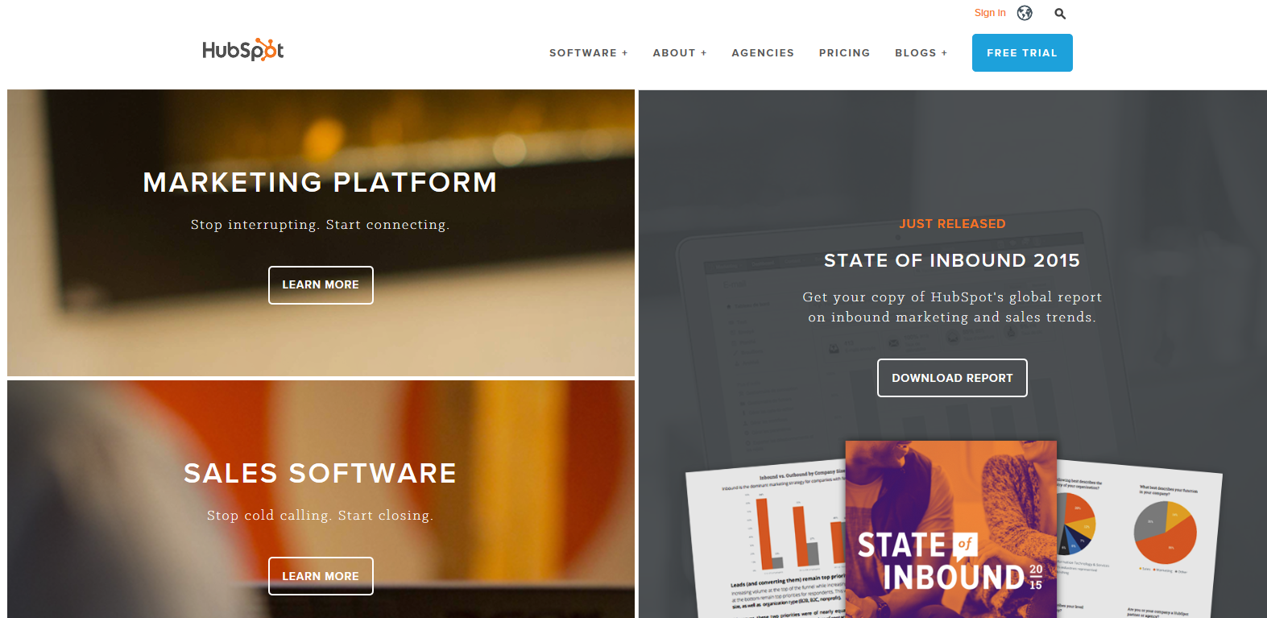
CUSTOMER ACQUISITION
Prospect Lists

Slide 5
CUSTOMER ACQUISITION
How Do Firms Acquire Customers?
Inbound Marketing
Search engine optimization
Blogs
Social media
“Viral” marketing
Content Creation and Distribution
Outbound Marketing
Broadcast advertising
Display/Search advertising
Sales calls
Email marketing
Direct mail
Trade shows
Direct Marketing

Slide 6
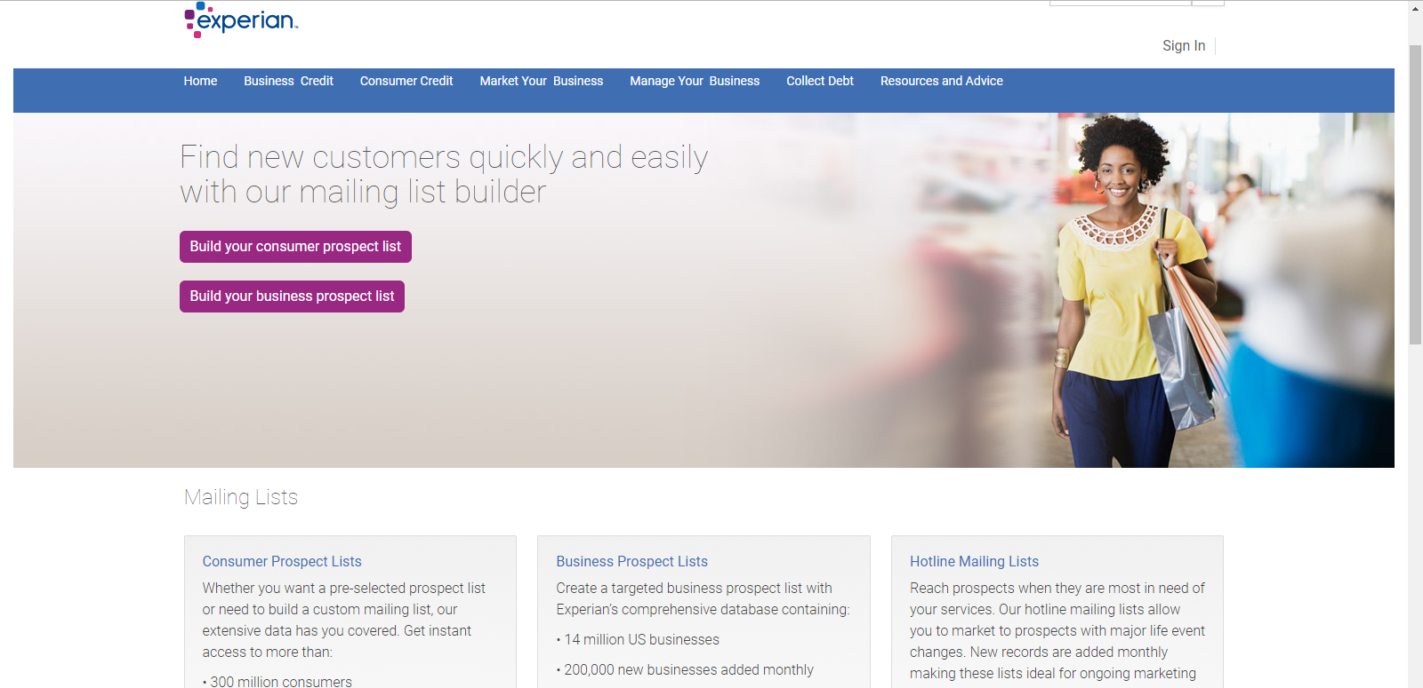
CUSTOMER ACQUISITION
Where Do We Get Prospects?

Slide 7
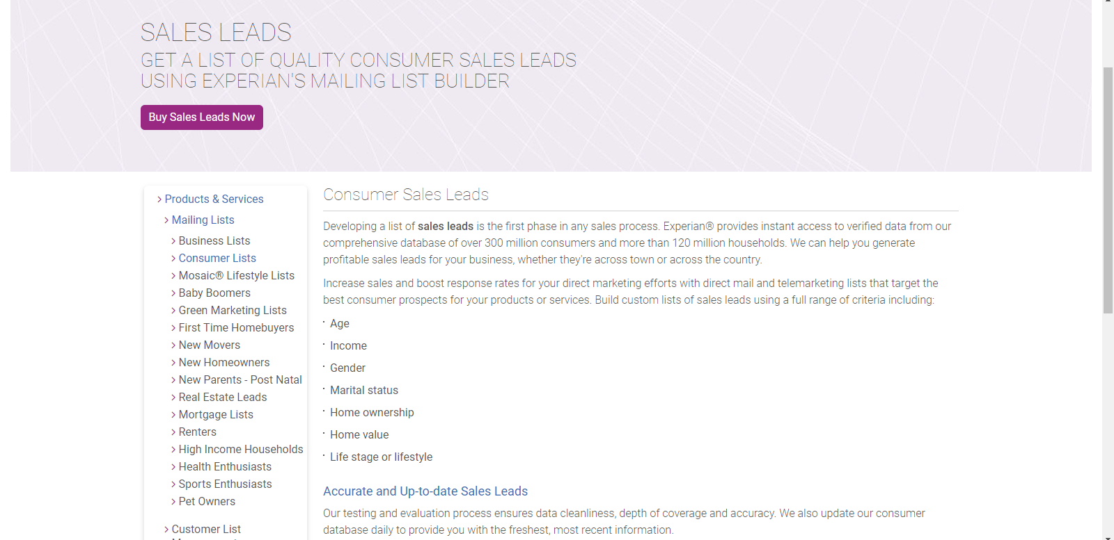
CUSTOMER ACQUISITION
At Minimum We Get Demographic Data

Slide 8
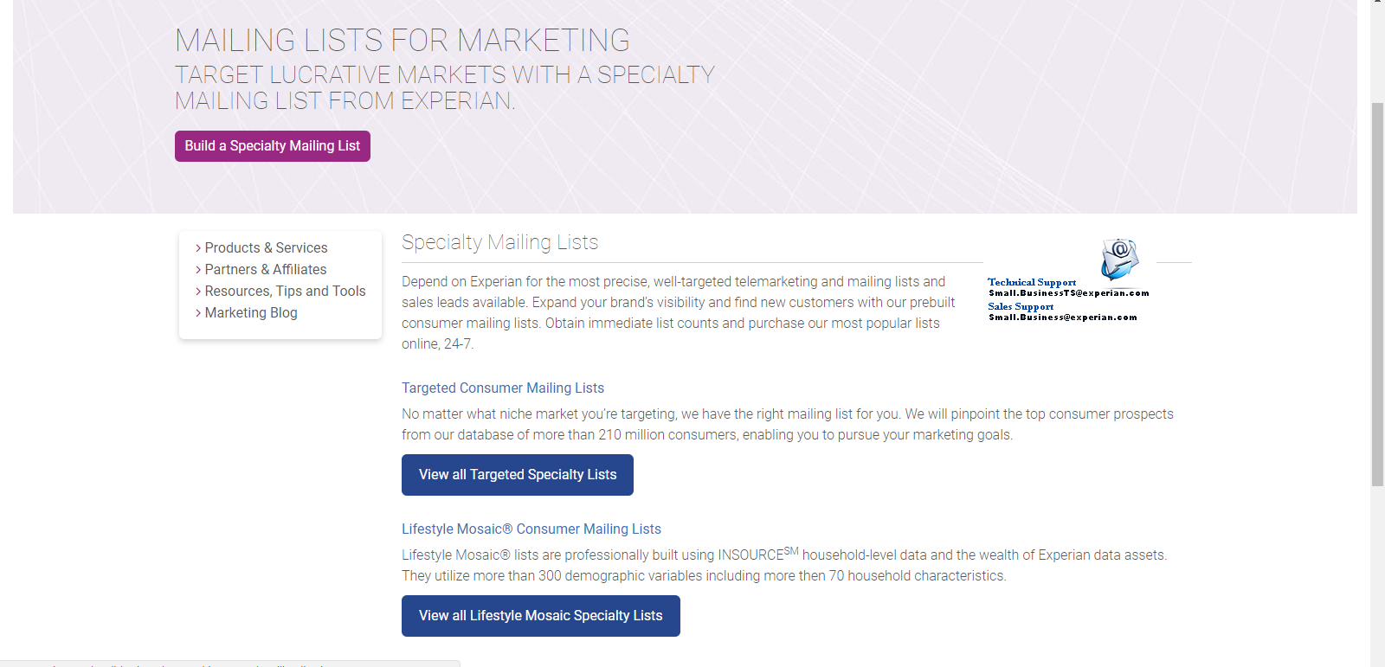
CUSTOMER ACQUISITION
We Can Also Get More Detailed Data (if we pay…)

Slide 9
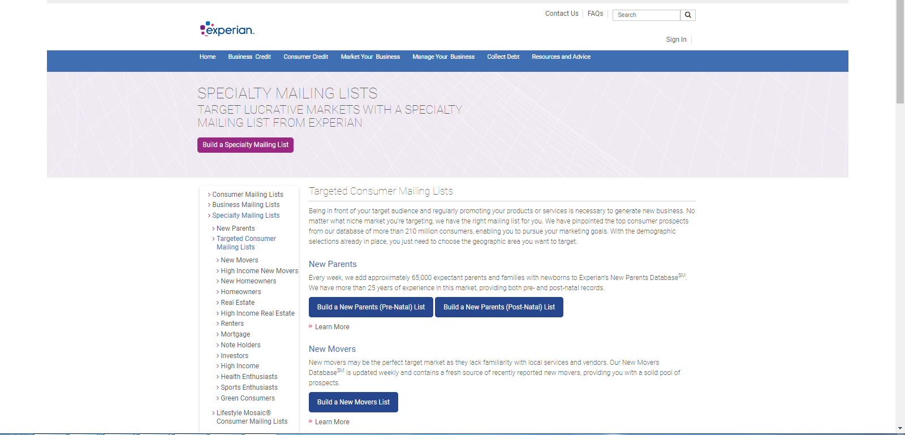
CUSTOMER ACQUISITION
We Can Also Get More Detailed Data

Slide 10
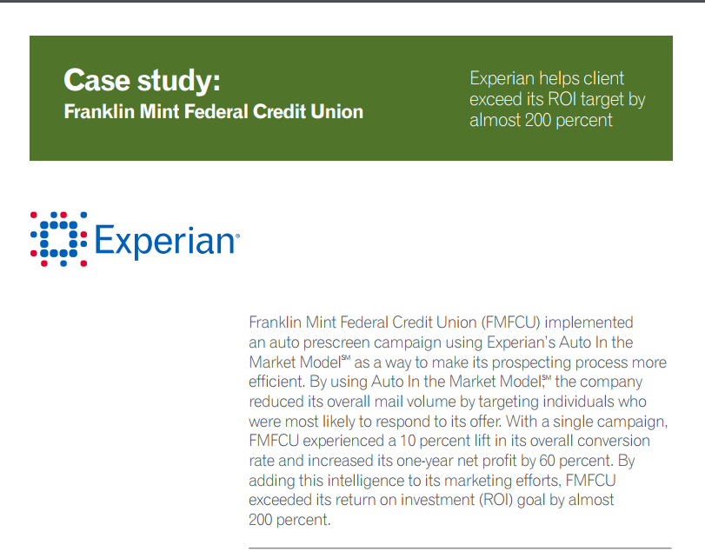
CUSTOMER ACQUISITION
How to Proceed…
You could buy 500,000 names and roll the dice
You could buy a subset of names and conduct some tests
The goal of the test would be to develop a scoring model you could use to score a larger list

Slide 11
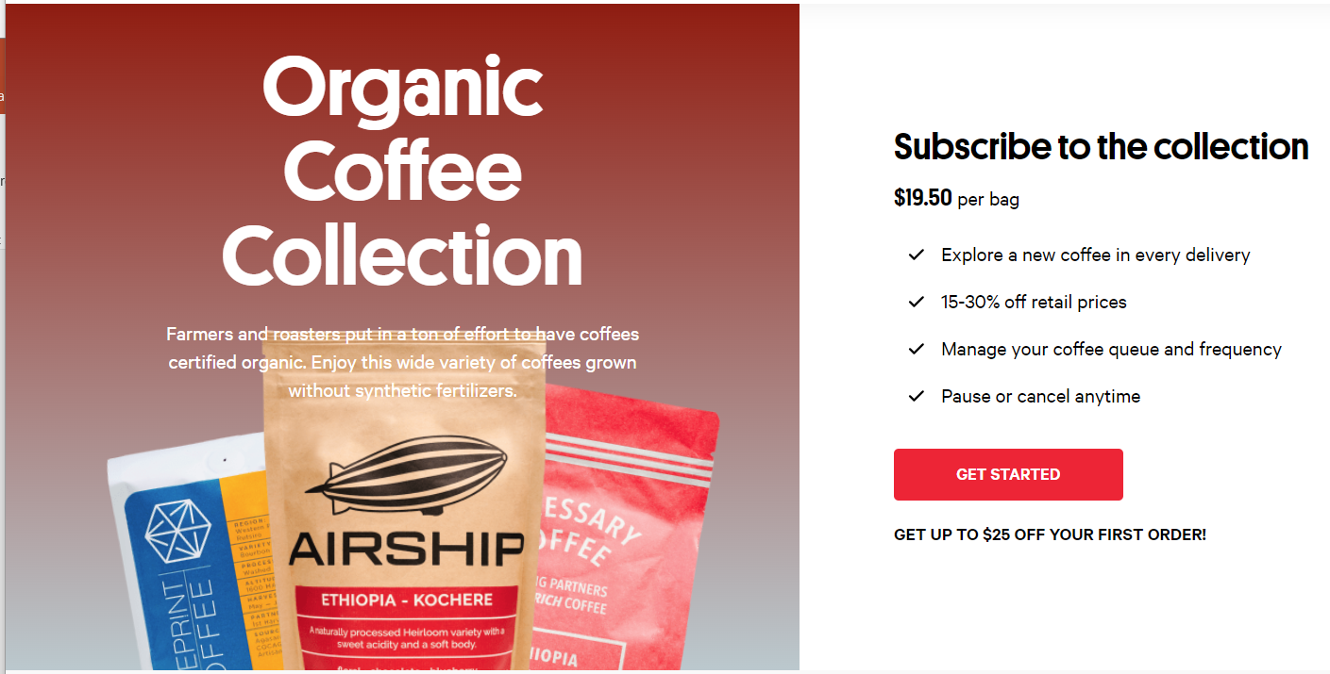
CUSTOMER ACQUISITION
Model Based List Scoring

Slide 12
CUSTOMER ACQUISITION
Model Based List Scoring
1. Obtain a list of prospects to test (N=500 in our example here)
2. “Populate” the list with some predictors (usually from list provider)
Demographics
Buying index scores which index prospects in terms of category or segment interest (coffee, eco-friendly products, etc.)
List Scoring
Notes:
So the research question here is
whether (and how) demand uncertainty impacts consumer choice between three-part tariffs (DEMAND = USAGE)
And what the effect of this demand uncertainty is on consumer surplus and provider revenue UNDER THREE-PART TARIFFS
Even though there is a lot of plans like this it is turns out, that this is not well studied
You might ask – well, why is this relevant, why care about it
First, understanding consumer behavior helps firms to set prices (potentially also segment along usage uncertainty, not only usage level)
Regulators to monitor firms’ pricing behavior
Researchers to understand why three-part tariffs are so common
I will now set out to
First, give an intuitive explanation
Then, introduce my data and a model
Last, show empirical results that show the role of uncertainty

Slide 13
CUSTOMER ACQUISITION
Model Based List Scoring
Populate the list with predictors
We purchase data on three variables:
x₁: binary education indicator (college or more=1)
x₂: buying index 1 (index measures coffee purchase interest)
x₃: buying index 2 (index measures eco friendly purchase interest)
List Scoring
Notes:
So the research question here is
whether (and how) demand uncertainty impacts consumer choice between three-part tariffs (DEMAND = USAGE)
And what the effect of this demand uncertainty is on consumer surplus and provider revenue UNDER THREE-PART TARIFFS
Even though there is a lot of plans like this it is turns out, that this is not well studied
You might ask – well, why is this relevant, why care about it
First, understanding consumer behavior helps firms to set prices (potentially also segment along usage uncertainty, not only usage level)
Regulators to monitor firms’ pricing behavior
Researchers to understand why three-part tariffs are so common
I will now set out to
First, give an intuitive explanation
Then, introduce my data and a model
Last, show empirical results that show the role of uncertainty

Slide 14
CUSTOMER ACQUISITION
Model Based List Scoring
3. Measure responses of all customers
Run an experiment (i.e., direct mail subscription offer)
y is the observed response (0 = no, 1 = yes)
List Scoring
We want to know the probability of response given x1, x2 and x3
Notes:
So the research question here is
whether (and how) demand uncertainty impacts consumer choice between three-part tariffs (DEMAND = USAGE)
And what the effect of this demand uncertainty is on consumer surplus and provider revenue UNDER THREE-PART TARIFFS
Even though there is a lot of plans like this it is turns out, that this is not well studied
You might ask – well, why is this relevant, why care about it
First, understanding consumer behavior helps firms to set prices (potentially also segment along usage uncertainty, not only usage level)
Regulators to monitor firms’ pricing behavior
Researchers to understand why three-part tariffs are so common
I will now set out to
First, give an intuitive explanation
Then, introduce my data and a model
Last, show empirical results that show the role of uncertainty

Slide 15
CUSTOMER ACQUISITION
Model Based List Scoring
4. Divide list into data for model estimation and holdout data for model testing
Estimation sample (i.e., data to estimate parameters)
Holdout sample (i.e., data to test model prediction)
In our example we have N=200 in estimation sample and N=300 in holdout sample
List Scoring
We want to know the probability of response given x1, x2 and x3
Notes:
So the research question here is
whether (and how) demand uncertainty impacts consumer choice between three-part tariffs (DEMAND = USAGE)
And what the effect of this demand uncertainty is on consumer surplus and provider revenue UNDER THREE-PART TARIFFS
Even though there is a lot of plans like this it is turns out, that this is not well studied
You might ask – well, why is this relevant, why care about it
First, understanding consumer behavior helps firms to set prices (potentially also segment along usage uncertainty, not only usage level)
Regulators to monitor firms’ pricing behavior
Researchers to understand why three-part tariffs are so common
I will now set out to
First, give an intuitive explanation
Then, introduce my data and a model
Last, show empirical results that show the role of uncertainty

Slide 16
MODEL BASED SCORING
In General, We Need Two Things
We need a function g that maps the x variables into an propensity to respond score
We need a link function f that maps the score into a probability
Does this look familiar? It should…
Notes:
So the research question here is
whether (and how) demand uncertainty impacts consumer choice between three-part tariffs (DEMAND = USAGE)
And what the effect of this demand uncertainty is on consumer surplus and provider revenue UNDER THREE-PART TARIFFS
Even though there is a lot of plans like this it is turns out, that this is not well studied
You might ask – well, why is this relevant, why care about it
First, understanding consumer behavior helps firms to set prices (potentially also segment along usage uncertainty, not only usage level)
Regulators to monitor firms’ pricing behavior
Researchers to understand why three-part tariffs are so common
I will now set out to
First, give an intuitive explanation
Then, introduce my data and a model
Last, show empirical results that show the role of uncertainty

Slide 17
MODEL BASED SCORING
Let’s Start With the Score Function
Example of score function: Linear Effects
Example of score function: Linear Effects Plus Interactions
Example of score function: Multiplicative Effects (if x’s are all >0)
Notes:
So the research question here is
whether (and how) demand uncertainty impacts consumer choice between three-part tariffs (DEMAND = USAGE)
And what the effect of this demand uncertainty is on consumer surplus and provider revenue UNDER THREE-PART TARIFFS
Even though there is a lot of plans like this it is turns out, that this is not well studied
You might ask – well, why is this relevant, why care about it
First, understanding consumer behavior helps firms to set prices (potentially also segment along usage uncertainty, not only usage level)
Regulators to monitor firms’ pricing behavior
Researchers to understand why three-part tariffs are so common
I will now set out to
First, give an intuitive explanation
Then, introduce my data and a model
Last, show empirical results that show the role of uncertainty

Slide 18
MODEL BASED SCORING
Now Consider the Link Between the Score and the Probability of Response
The Logit Link (hello, old friend…)
The Probit Link
The Complementary Log-Log Link
Notes:
So the research question here is
whether (and how) demand uncertainty impacts consumer choice between three-part tariffs (DEMAND = USAGE)
And what the effect of this demand uncertainty is on consumer surplus and provider revenue UNDER THREE-PART TARIFFS
Even though there is a lot of plans like this it is turns out, that this is not well studied
You might ask – well, why is this relevant, why care about it
First, understanding consumer behavior helps firms to set prices (potentially also segment along usage uncertainty, not only usage level)
Regulators to monitor firms’ pricing behavior
Researchers to understand why three-part tariffs are so common
I will now set out to
First, give an intuitive explanation
Then, introduce my data and a model
Last, show empirical results that show the role of uncertainty

Slide 19
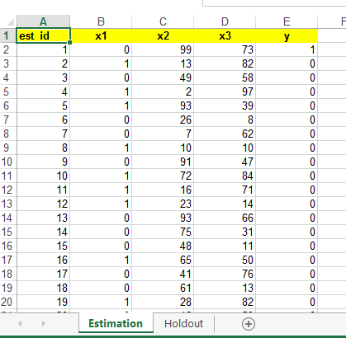
MODEL BASED SCORING
Let’s Estimate Some Models

Slide 20
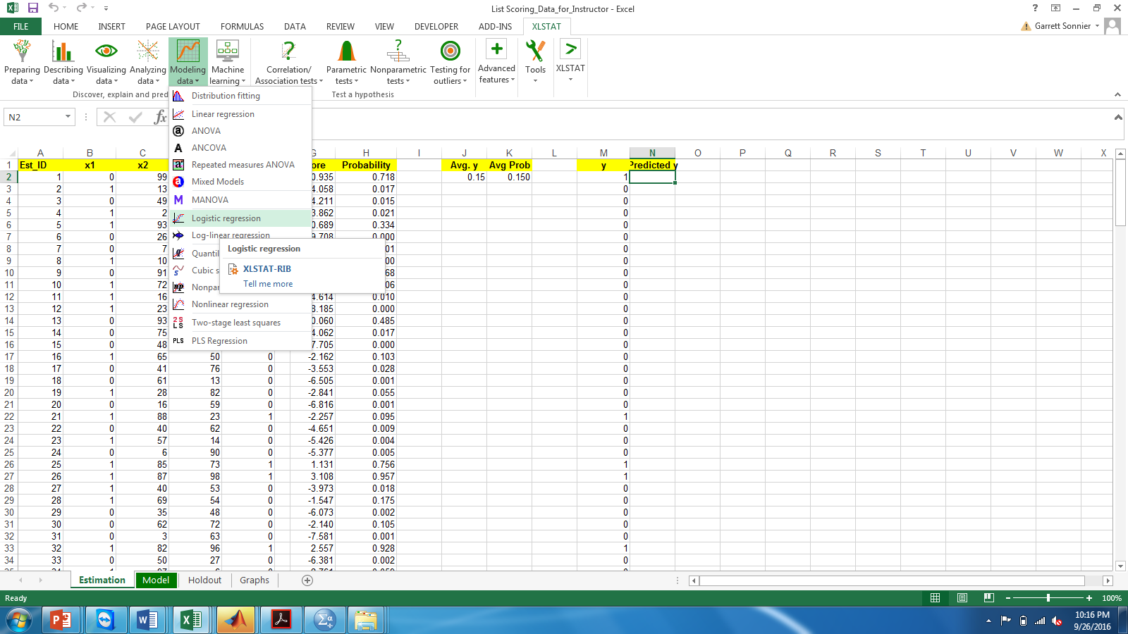
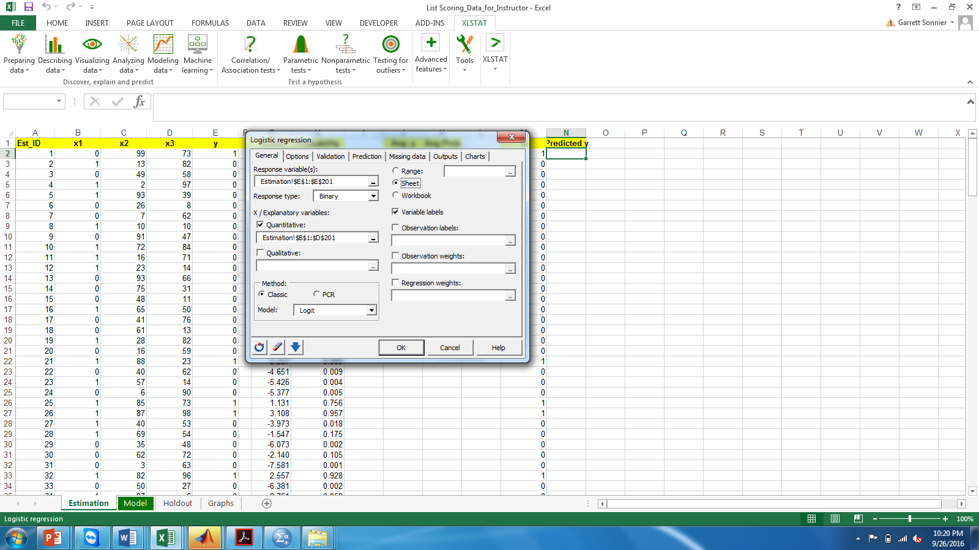
MODEL BASED SCORING
Model Estimation
Model estimated on N=200 consumers in estimation sample

Slide 21
MODEL BASED SCORING
Model Estimation
Logit

Slide 22
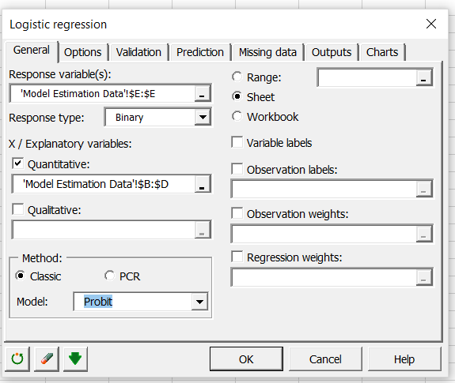
MODEL BASED SCORING
Let’s Estimate Some Models

Slide 23
MODEL BASED SCORING
Model Estimation
Probit

Slide 24
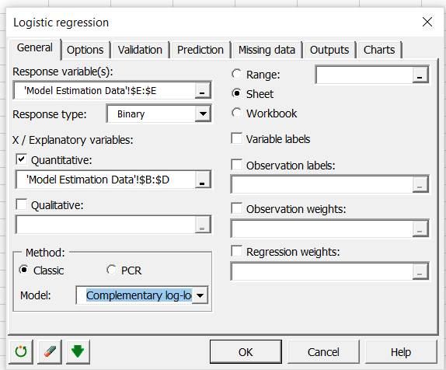
MODEL BASED SCORING
Let’s Estimate Some Models

Slide 25
MODEL BASED SCORING
Model Estimation
C Log-Log

Slide 26
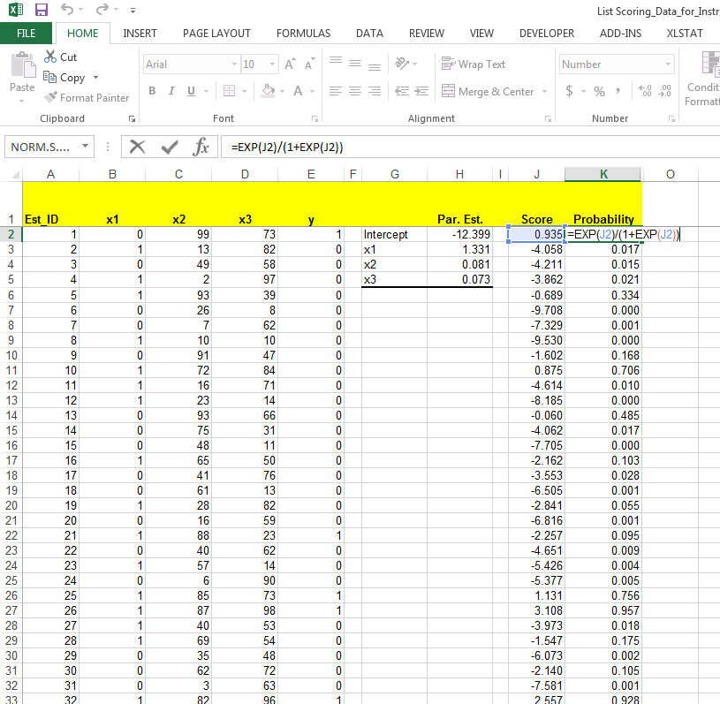
MODEL BASED SCORING
Logit Model Probabilities

Slide 27
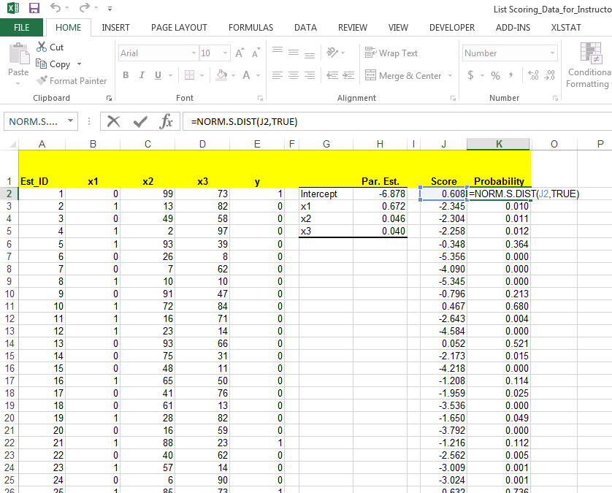
MODEL BASED SCORING
Probit Model Probabilities

Slide 28
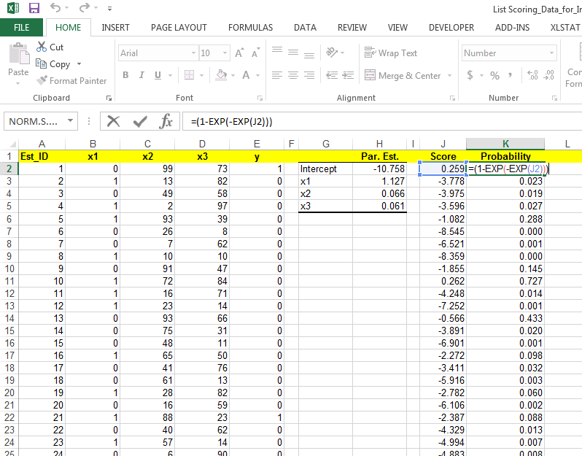
MODEL BASED SCORING
C Log Log Model Probabilities

Slide 29
MODEL BASED SCORING
Comparing Model Probabilities
Not much difference across these models

Slide 30
MODEL BASED SCORING
In Sample (Training) Fit for the Logit Model
Let’s classify any probability >50% as “Buy” and any <50% as “Not Buy”
Predicted
Actual=1, Predicted=1: True Positive
Actual=1, Predicted=0: False Negative
Actual=0, Predicted=1: False Positive
Actual=0, Predicted=0: True Negative
Actuals
First Look at the Actual Positives
Hit Rate Among Actual Positives: True Positive/(True Positive+False Negative)
We call this the Sensitivity---60% in this case
Miss Rate Among Actual Positives: False Negative/(True Positive+False Negative)
We call this the Type II Error: (1-Sensitivity)---40% in this case

Slide 31
MODEL BASED SCORING
In Sample (Training) Fit for the Logit Model
Let’s classify any probability >50% as “Buy” and any <50% as “Not Buy”
Predicted
Actual=1, Predicted=1: True Positive
Actual=1, Predicted=0: False Negative
Actual=0, Predicted=1: False Positive
Actual=0, Predicted=0: True Negative
Actuals
Now Look at the Actual Negatives
Hit Rate Among Actual Negatives: True Negative/(True Negative+False Positive)
We call this the Specificity---96% in this case
Miss Rate Among Actual Negatives: False Positive/(True Negative+False Positive)
We call this Type I Error: (1-Specificity)---4% in this case

Slide 32
MODEL BASED SCORING
In Sample (Training) Fit for All Three Models
The Logit
Predicted
Actuals
The Probit
Predicted
Actuals
The C Log Log
Predicted
Actuals

Slide 33
MODEL BASED SCORING
What is a “Good” Cutoff For a Given Model?
In terms of Sensitivity (True Positive Rate)
In terms of Specificity (True Negative Rate)
This is the point where both sensitivity and specificity of model are perfect
EXAMPLE GRAPH
You end up here by using a cutoff of 0 so that you always predict 1. No false negatives. Everyone targeted.
You end up here by using a cutoff of 1 so that you always predict 0. No false positives. No one targeted.
This is a tradeoff between the cost of erroneous targeting decision vs the value of a missed opportunity
One option is to choose cutoff probability between such that distance to (0,1) point on graph is minimized

Slide 34
MODEL BASED SCORING
What About a Model with Interactions?
Example of score function: Linear Effects
Example of score function: Linear Effects Plus Interactions
The Logit (2 x Interactions)
The Logit (Main Effects Only)
Predicted
Predicted
Actuals
Actuals

Slide 35
MODEL BASED SCORING
Let’s Look at the Holdout Data

Slide 36
MODEL BASED SCORING
What About a Model with Interactions?

Slide 37
MODEL BASED SCORING
What About a Model with Interactions?
Interactions Model
Main Effects Model
Simpler main effects model performs better
Hit rate higher
At 50% cutoff distance to (0,1) on ROC graph is smaller

Slide 38
CUSTOMER ACQUISITION
Model Estimation
A binary logit model on our 200 observations:
Results
Linear Regressions: the coefficients measure the change in y given a unit increase in x
Logit coefficients are less straightforward
In Logit we have p(y=1) and p(y=0)=1-p(y=1)
We can look at how a unit change in x impacts the ratio of p(y=1) / p(y=0)---the odds ratio.
We can look at how a unit change in x impacts the probability p(y=1)
Interpretation
Notes:
This concept actually stems from John Hagel's and Marc Singer's HBR and McK Quarterly article "Unbundling the Corporation". Their hypothesis is that decreasing interaction costs will drive corporations (or at least those intent on staying competitive) to disaggregate according to the above overall "functions".
We introduce this concept to business unit strategy to help teams focus on those functions of the client and their competitors which are most crucial on the competitive battlefield. Thus most investigative effort will be spent where it really matters. In the pyramid introduced above we give some suggestions which frameworks/tools/concepts can be helpful for further analysis depending on the driver(s) of the business.
Of course many business units will have more than one value driver. A pharmaceutical BU, for example, might very well be competing as a customer relationship business (targeting its sales force for maximum impact with physicians) as well as competing as an innovation business (developing and managing its drug pipeline). Both drivers of the business will need to be examined by the team. In the spirit of Hagel and Singer this might also be the starting point to investigate possibilities to unbundle the functions of the BU or the corporation and have the client focus on the game he's prepared to play best at.

Slide 39
CUSTOMER ACQUISITION
How to Evaluate a Change in X: The Odds Ratio
Buy
Don’t Buy
The odds ratio.
What are the odds buying when x1=0, x2=50 and x3=50
What are the odds buying when x1=0, x2=51 and x3=50

Slide 40
CUSTOMER ACQUISITION
How to Evaluate a Change in X
The odds ratio.
What are the odds buying when x1=0, x2=50 and x3=50
What are the odds buying when x1=0, x2=51 and x3=50
By what factor did the odds improve?

Slide 41
CUSTOMER ACQUISITION
How to Evaluate a Change in X
The odds ratio.
What if x2 went from 90 to 91?

Slide 42
CUSTOMER ACQUISITION
How to Evaluate a Change in X
The odds ratio.

Slide 43
CUSTOMER ACQUISITION
How to Evaluate a Change in X
The Increase in the Odds Ratio (for a one unit increase in X)
A one unit increase in x2 yields an 8.5% increase in the odds of buying
What about x1?
What about x3?
What about the probability of buying (not the odds)?

Slide 44
CUSTOMER ACQUISITION
How to Evaluate a One Unit Change in X
Effect of a unit change in x on the probability of buying
It depends on how likely you are to buy or not buy in the first place!
Assume you are very likely to buy (Pr=.99)
What is the value of Pr x (1-Pr)?
Assume you are very unlikely to buy (Pr=.01)
What is the value of Pr x (1-Pr)?
For what value of Pr will Pr x (1-Pr) be the highest? What (if any!) intuition do you take from this?

Slide 45
CUSTOMER ACQUISITION
How to Evaluate a One Unit Change in X: Change in the Choice Probability
On the Probability Itself via Calculus
On the Probability Itself via Brute Force

Slide 46
CUSTOMER ACQUISITION
Model Estimation
If we run a logistic regression on our list we get:
Results
To get the effect on the probability we need to
Compute the score
Use the score to get the probability for each observation (i=1,…,200)
Compute for each i=1,…,200
Average over all observations
Marginal Effects for a Unit Increase in X2
Notes:
This concept actually stems from John Hagel's and Marc Singer's HBR and McK Quarterly article "Unbundling the Corporation". Their hypothesis is that decreasing interaction costs will drive corporations (or at least those intent on staying competitive) to disaggregate according to the above overall "functions".
We introduce this concept to business unit strategy to help teams focus on those functions of the client and their competitors which are most crucial on the competitive battlefield. Thus most investigative effort will be spent where it really matters. In the pyramid introduced above we give some suggestions which frameworks/tools/concepts can be helpful for further analysis depending on the driver(s) of the business.
Of course many business units will have more than one value driver. A pharmaceutical BU, for example, might very well be competing as a customer relationship business (targeting its sales force for maximum impact with physicians) as well as competing as an innovation business (developing and managing its drug pipeline). Both drivers of the business will need to be examined by the team. In the spirit of Hagel and Singer this might also be the starting point to investigate possibilities to unbundle the functions of the BU or the corporation and have the client focus on the game he's prepared to play best at.

Slide 47
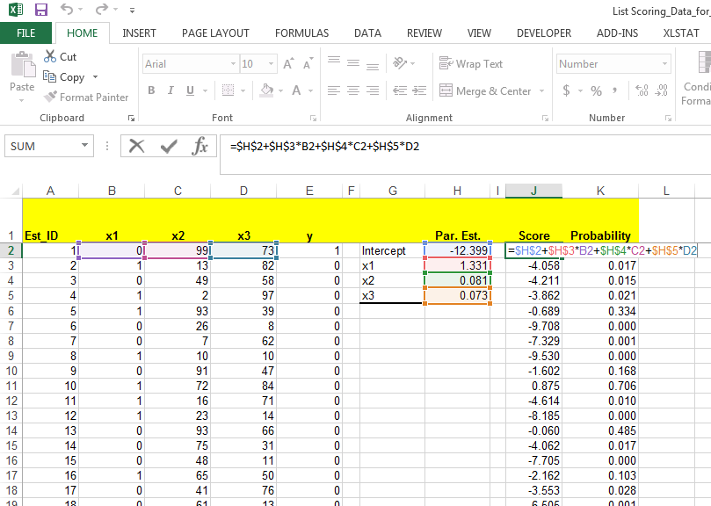
CUSTOMER ACQUISITION
First We Compute the Score

Slide 48
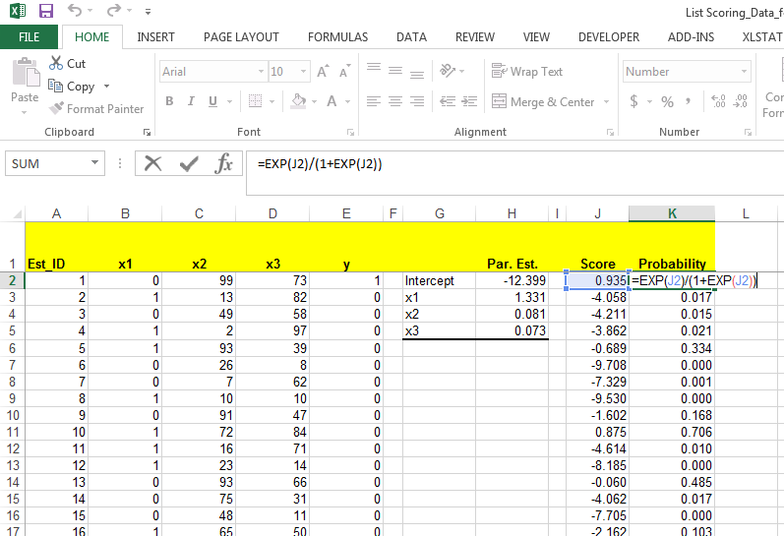
CUSTOMER ACQUISITION
Then We Compute the Probability

Slide 49
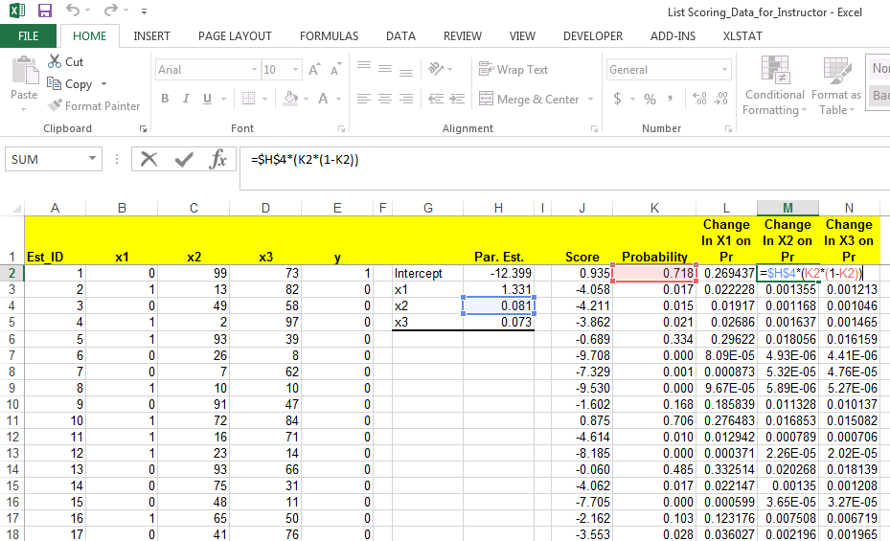
CUSTOMER ACQUISITION
Use the Estimated Parameters and the Probabilities to Compute the Effects

Slide 50
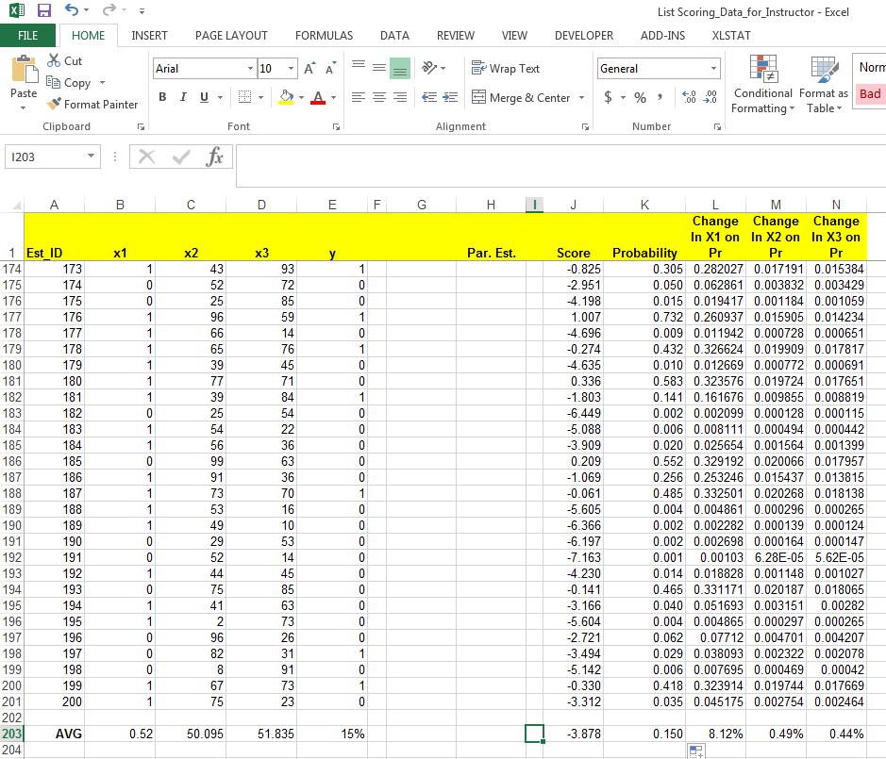
CUSTOMER ACQUISITION
Take the Average

Slide 51
CUSTOMER ACQUISITION
Take Care Interpreting the Average Effect
Case 1
Case 2
Case 3

Slide 52
CUSTOMER ACQUISITION
Testing the Model: How Well Did We Do?
Consider our 300 holdout addresses
→ Based on the model, who should the firm contact?
Scan & Refine
…
Notes:
So the research question here is
whether (and how) demand uncertainty impacts consumer choice between three-part tariffs (DEMAND = USAGE)
And what the effect of this demand uncertainty is on consumer surplus and provider revenue UNDER THREE-PART TARIFFS
Even though there is a lot of plans like this it is turns out, that this is not well studied
You might ask – well, why is this relevant, why care about it
First, understanding consumer behavior helps firms to set prices (potentially also segment along usage uncertainty, not only usage level)
Regulators to monitor firms’ pricing behavior
Researchers to understand why three-part tariffs are so common
I will now set out to
First, give an intuitive explanation
Then, introduce my data and a model
Last, show empirical results that show the role of uncertainty

Slide 53
CUSTOMER ACQUISITION
Compute for each person on the holdout list
The predicted score conditional on observed X’s and estimated model coefficients
The predicted response probability
The predicted lift
Notes:
So the research question here is
whether (and how) demand uncertainty impacts consumer choice between three-part tariffs (DEMAND = USAGE)
And what the effect of this demand uncertainty is on consumer surplus and provider revenue UNDER THREE-PART TARIFFS
Even though there is a lot of plans like this it is turns out, that this is not well studied
You might ask – well, why is this relevant, why care about it
First, understanding consumer behavior helps firms to set prices (potentially also segment along usage uncertainty, not only usage level)
Regulators to monitor firms’ pricing behavior
Researchers to understand why three-part tariffs are so common
I will now set out to
First, give an intuitive explanation
Then, introduce my data and a model
Last, show empirical results that show the role of uncertainty

Slide 54
CUSTOMER ACQUISITION
Results for the first 12 prospects
Over all 200 estimation households the average p(y=1) is 0.15
Notes:
So the research question here is
whether (and how) demand uncertainty impacts consumer choice between three-part tariffs (DEMAND = USAGE)
And what the effect of this demand uncertainty is on consumer surplus and provider revenue UNDER THREE-PART TARIFFS
Even though there is a lot of plans like this it is turns out, that this is not well studied
You might ask – well, why is this relevant, why care about it
First, understanding consumer behavior helps firms to set prices (potentially also segment along usage uncertainty, not only usage level)
Regulators to monitor firms’ pricing behavior
Researchers to understand why three-part tariffs are so common
I will now set out to
First, give an intuitive explanation
Then, introduce my data and a model
Last, show empirical results that show the role of uncertainty

Slide 55
CUSTOMER ACQUISITION
Sort the prospects in decreasing order of response probability
Notes:
So the research question here is
whether (and how) demand uncertainty impacts consumer choice between three-part tariffs (DEMAND = USAGE)
And what the effect of this demand uncertainty is on consumer surplus and provider revenue UNDER THREE-PART TARIFFS
Even though there is a lot of plans like this it is turns out, that this is not well studied
You might ask – well, why is this relevant, why care about it
First, understanding consumer behavior helps firms to set prices (potentially also segment along usage uncertainty, not only usage level)
Regulators to monitor firms’ pricing behavior
Researchers to understand why three-part tariffs are so common
I will now set out to
First, give an intuitive explanation
Then, introduce my data and a model
Last, show empirical results that show the role of uncertainty

Slide 56
CUSTOMER ACQUISITION
Consider n offers made to the n ”best” prospects
Plot each value of n against the nth highest predicted response rate
Marginal Response Rate vs. Number of Solicitation made
Notes:
So the research question here is
whether (and how) demand uncertainty impacts consumer choice between three-part tariffs (DEMAND = USAGE)
And what the effect of this demand uncertainty is on consumer surplus and provider revenue UNDER THREE-PART TARIFFS
Even though there is a lot of plans like this it is turns out, that this is not well studied
You might ask – well, why is this relevant, why care about it
First, understanding consumer behavior helps firms to set prices (potentially also segment along usage uncertainty, not only usage level)
Regulators to monitor firms’ pricing behavior
Researchers to understand why three-part tariffs are so common
I will now set out to
First, give an intuitive explanation
Then, introduce my data and a model
Last, show empirical results that show the role of uncertainty

Slide 57
CUSTOMER ACQUISITION
Consider n solicitations made to the “n” best prospects
If n solicitations are made to the n “best” prospects, the expected number of responses ( = sales) is the cumulative sum of the n highest values of p(y=1)
Total # of predicted sales is 37.837
Notes:
So the research question here is
whether (and how) demand uncertainty impacts consumer choice between three-part tariffs (DEMAND = USAGE)
And what the effect of this demand uncertainty is on consumer surplus and provider revenue UNDER THREE-PART TARIFFS
Even though there is a lot of plans like this it is turns out, that this is not well studied
You might ask – well, why is this relevant, why care about it
First, understanding consumer behavior helps firms to set prices (potentially also segment along usage uncertainty, not only usage level)
Regulators to monitor firms’ pricing behavior
Researchers to understand why three-part tariffs are so common
I will now set out to
First, give an intuitive explanation
Then, introduce my data and a model
Last, show empirical results that show the role of uncertainty

Slide 58
CUSTOMER ACQUISITION
Consider n solicitations made to the “n” best prospects
Plot each value of n against the expected number of responses
Number of Responses vs. Number of Solicitation made
Notes:
So the research question here is
whether (and how) demand uncertainty impacts consumer choice between three-part tariffs (DEMAND = USAGE)
And what the effect of this demand uncertainty is on consumer surplus and provider revenue UNDER THREE-PART TARIFFS
Even though there is a lot of plans like this it is turns out, that this is not well studied
You might ask – well, why is this relevant, why care about it
First, understanding consumer behavior helps firms to set prices (potentially also segment along usage uncertainty, not only usage level)
Regulators to monitor firms’ pricing behavior
Researchers to understand why three-part tariffs are so common
I will now set out to
First, give an intuitive explanation
Then, introduce my data and a model
Last, show empirical results that show the role of uncertainty

Slide 59
CUSTOMER ACQUISITION
Model Assessment

Slide 60
CUSTOMER ACQUISITION
Cutoff For Targeting
1. Obtain a list of prospects
…
7. Find best targets according to decision criteria
Limited Supply Rule
Marginal Supply Rule
List Scoring
Notes:
So the research question here is
whether (and how) demand uncertainty impacts consumer choice between three-part tariffs (DEMAND = USAGE)
And what the effect of this demand uncertainty is on consumer surplus and provider revenue UNDER THREE-PART TARIFFS
Even though there is a lot of plans like this it is turns out, that this is not well studied
You might ask – well, why is this relevant, why care about it
First, understanding consumer behavior helps firms to set prices (potentially also segment along usage uncertainty, not only usage level)
Regulators to monitor firms’ pricing behavior
Researchers to understand why three-part tariffs are so common
I will now set out to
First, give an intuitive explanation
Then, introduce my data and a model
Last, show empirical results that show the role of uncertainty

Slide 61
CUSTOMER ACQUISITION
Cutoff For Targeting
1. Obtain a list of prospects
…
7. Find best targets according to decision criteria
Limited Supply Rule: Suppose firm has only k items. Then the firm should choose n such that the sum of n highest predicted response rate, SUM_p(y=1), is just under k
Example k=20
List Scoring
Notes:
So the research question here is
whether (and how) demand uncertainty impacts consumer choice between three-part tariffs (DEMAND = USAGE)
And what the effect of this demand uncertainty is on consumer surplus and provider revenue UNDER THREE-PART TARIFFS
Even though there is a lot of plans like this it is turns out, that this is not well studied
You might ask – well, why is this relevant, why care about it
First, understanding consumer behavior helps firms to set prices (potentially also segment along usage uncertainty, not only usage level)
Regulators to monitor firms’ pricing behavior
Researchers to understand why three-part tariffs are so common
I will now set out to
First, give an intuitive explanation
Then, introduce my data and a model
Last, show empirical results that show the role of uncertainty

Slide 62
CUSTOMER ACQUISITION
Cutoff For Targeting: Limited Supply Rule: k=20

Slide 63
CUSTOMER ACQUISITION
Cutoff For Targeting
1. Obtain a list of prospects
…
7. Find best targets according to decision criteria
Limited Supply Rule: Suppose firm has only k items. Then the firm should choose n such that the sum of n highest predicted response rate, SUM_p(y=1), is just under k
Example k=20: we find that SUM_p(y=1) is 19.57 for n=25 and 20.08 for n=26
→ The firm should mail to the 25 highest prospects
List Scoring
Notes:
So the research question here is
whether (and how) demand uncertainty impacts consumer choice between three-part tariffs (DEMAND = USAGE)
And what the effect of this demand uncertainty is on consumer surplus and provider revenue UNDER THREE-PART TARIFFS
Even though there is a lot of plans like this it is turns out, that this is not well studied
You might ask – well, why is this relevant, why care about it
First, understanding consumer behavior helps firms to set prices (potentially also segment along usage uncertainty, not only usage level)
Regulators to monitor firms’ pricing behavior
Researchers to understand why three-part tariffs are so common
I will now set out to
First, give an intuitive explanation
Then, introduce my data and a model
Last, show empirical results that show the role of uncertainty

Slide 64
CUSTOMER ACQUISITION
Rollout Run
1. Obtain a list of prospects
…
7. Find best targets according to decision criteria
Marginal Supply Rule: Choose the highest value of n such that the nth highest predicted response rate p_{n} is
p_{n} ∙ E(CLV) > solicitation cost
p_{n} > solicitation cost / E(CLV)
Suppose average CLV is $30, and the solicitation cost is $6. The firm should target as long as the marginal response probability exceeds 0.20. In our example, this corresponds to n=58
List Scoring
Notes:
So the research question here is
whether (and how) demand uncertainty impacts consumer choice between three-part tariffs (DEMAND = USAGE)
And what the effect of this demand uncertainty is on consumer surplus and provider revenue UNDER THREE-PART TARIFFS
Even though there is a lot of plans like this it is turns out, that this is not well studied
You might ask – well, why is this relevant, why care about it
First, understanding consumer behavior helps firms to set prices (potentially also segment along usage uncertainty, not only usage level)
Regulators to monitor firms’ pricing behavior
Researchers to understand why three-part tariffs are so common
I will now set out to
First, give an intuitive explanation
Then, introduce my data and a model
Last, show empirical results that show the role of uncertainty

Slide 65
CUSTOMER ACQUISITION
Cutoff For Targeting: Marginal Supply Rule
…

Slide 66
MONETARY VALUE OF SCORING
y_{p} – predicted response probability
c – cutoff threshold for y_{p} for mailing
y_{actual} – 1 if prospects responds, 0 otherwise
R – list rental cost per contact
S – solicitation cost per contact
E – average customer value per successful acquisition
Variables
Profit
The profit from generated from a customer on the list is
- R , if y_{p} < c
- R- S , if y_{p} > c and y_{actual} = 0
E - R - S , if y_{p} > c and y_{actual} =1
Calculate the profits with and without targeting
Notes:
This concept actually stems from John Hagel's and Marc Singer's HBR and McK Quarterly article "Unbundling the Corporation". Their hypothesis is that decreasing interaction costs will drive corporations (or at least those intent on staying competitive) to disaggregate according to the above overall "functions".
We introduce this concept to business unit strategy to help teams focus on those functions of the client and their competitors which are most crucial on the competitive battlefield. Thus most investigative effort will be spent where it really matters. In the pyramid introduced above we give some suggestions which frameworks/tools/concepts can be helpful for further analysis depending on the driver(s) of the business.
Of course many business units will have more than one value driver. A pharmaceutical BU, for example, might very well be competing as a customer relationship business (targeting its sales force for maximum impact with physicians) as well as competing as an innovation business (developing and managing its drug pipeline). Both drivers of the business will need to be examined by the team. In the spirit of Hagel and Singer this might also be the starting point to investigate possibilities to unbundle the functions of the BU or the corporation and have the client focus on the game he's prepared to play best at.

Slide 67
LIST SCORING – RESULTS
Example: S=6, E=30, c=0.2, R=1
Notes:
So the research question here is
whether (and how) demand uncertainty impacts consumer choice between three-part tariffs (DEMAND = USAGE)
And what the effect of this demand uncertainty is on consumer surplus and provider revenue UNDER THREE-PART TARIFFS
Even though there is a lot of plans like this it is turns out, that this is not well studied
You might ask – well, why is this relevant, why care about it
First, understanding consumer behavior helps firms to set prices (potentially also segment along usage uncertainty, not only usage level)
Regulators to monitor firms’ pricing behavior
Researchers to understand why three-part tariffs are so common
I will now set out to
First, give an intuitive explanation
Then, introduce my data and a model
Last, show empirical results that show the role of uncertainty

Slide 68
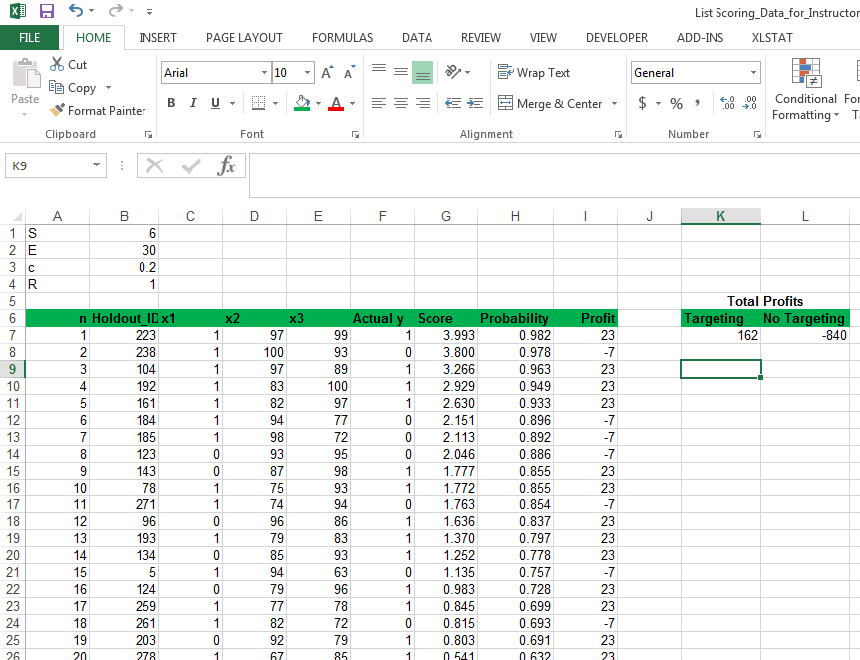
MONETARY VALUE OF SCORING

Slide 69
SCORING MODELS FOR CUSTOMER ACQUISITION
Key Concepts
Probability models give us the ability to score customer prospects on the basis of demographic and category interest variables
The score function maps observed predictor variables into a propensity to buy score
The link function maps the score into a probability between 0-1 conditional on the predictors
Model is estimated on estimation/training sample and validated on holdout/test sample
Once model is in place can use it to score a large list of customer prospects and make targeting decisions

